Slide 1
Introduction to GIS
Introduction to GIS Basics

Slide 2
Introduction to GIS
At the end of this session, you would be able to explain:
GIS, Users of GIS, Functions , Principle & component of GIS, Users of GIS etc.

Slide 3
What is GIS
GIS = Geographic Information System
– Links databases and maps
– Manages information about places
– Helps answer questions such as:
  Where is it?
  What else is nearby?
  Where is the highest concentration of ‘X’?
  Where can I find things with characteristic ‘Y’?
  Where is the closest ‘Z’ to my location?

Slide 4
What is GIS?
There are a number of definitions of GIS. Different groups of people (general public, planners, teachers, scientists) can find a different definition useful.
Here are some of them:
“GIS is much more than a container of maps in digital form”.
“A GIS is a computerized tool for solving geographic problems”
“GIS is a spatial decision support system”
“GIS is a mechanized inventory of geographically distributed features and facilities”
“GIS is a method for revealing patterns and processes in geographic information”
“GIS is a collection of computer hardware, software, and geographic data for capturing, managing, analyzing, and displaying all forms of geographically referenced information.”

Slide 5
What is GIS
Geographic Information System (GIS) is a computer-based system including software, hardware, people, and geographic information.

Slide 6
What is GIS
Geographic Information System (GIS) is a computer-based system including software, hardware, people, and geographic information

Slide 7
What is GIS
In short: “computerized mapping software ”
Formal definition
A Geographic Information System (GIS) is a computerized database management system for capture, storage, retrieval, manipulation, analysis and display of spatial (i.e. locationally defined) data.

Slide 8
What is GIS
Geographic/Geospatial Information
– information about places on the earth ’s surface
– knowledge about “what is where when”
GIS--what’s in the S?
– Systems: the technology
– Science: the concepts and theory
– Studies: the societal context

Slide 9
What is GIS
Geographic/Geospatial Information
– information about places on the earth ’s surface
– knowledge about “what is where when”
GIS--what’s in the S?
– Systems: the technology
– Science: the concepts and theory
– Studies: the societal context

Slide 10
What is GIS
A GIS is a system (hardware + database engine) that is designed to efficiently, assemble, store, update, analyze, manipulate, and display geographically referenced information (data identified by their locations).
A GIS also includes the people operating the system and the data that go into the system.

Slide 11
Geographic Information System
Geographic – 80% of government data collected is associated with some location in space.
Information - attributes, or the characteristics (data), can be used to symbolize and provide further insight into a given location.
System – an operation linking the information to the geography – which requires hardware, networks, software, data, and operational procedures.
GIS is not just software
GIS is not just for making maps

Slide 12
GIS Principles
Data Capture
Data sources are mainly obtained from manual digitization and scanning of aerial photographs, paper maps, and existing digital data sets.
Database Management and Update
Data security, data integrity, and data storage and retrieval, and data maintenance abilities
Geographic Analysis
The collected information is analyzed and interpreted qualitatively and quantitatively.
Preparing Result
One of the most exciting aspects of GIS technology is the variety of different ways in which the information can be presented.

Slide 13
GIS Functions
Data Capture
The input of data into a GIS can be achieved through many different methods of gathering. For example, aerial photography, scanning, digitizing, GPS or global positioning system is just a few of the ways a GIS user could obtain data.
Data Storage
Some data is stored such as a map, while others, such as digital data, can be as a hardcopy, stored on CD or on your hard drive.

Slide 14
GIS Functions
Data Manipulation
The digital geographical data can be edited, this allows for many attribute to be added, edited, or deleted to the specification of the project.
Query And Analysis
GIS was used widely in decision making process for the new commission districts. We use population data to help establish an equal representation of population to area for each district.
Visualization
This represents the ability to display your data, your maps, and information

Slide 15
Components of GIS
Hardware
Computer System, Scanner, Printer etc.
Software
GIS software in use are MapInfo, ARC/Info, AutoCAD Map, etc. The software available can be said to be application specific.
Data
A GIS will integrate spatial data with other data resources and can even use a DBMS, used by most organization to maintain their data, to manage spatial data. Geographic data and related tabular data can be collected in-house or purchased from a commercial data provider.

Slide 16
Components of GIS
People
GIS users range from technical specialists who design and maintain.
Method
The map creation can either be automated raster to vector creator or it can be manually victories using the scanned image

Slide 17
Who uses GIS?
International organizations
  UN HABITAT, The World Bank, UNEP, FAO, WHO, etc.
Private industry
  Transport, Real Estate, Insurance, etc.
Government
  Ministries of Environment, Housing, Agriculture, etc.
  Local Authorities, Cities, Municipalities, etc.
  Provincial Agencies for Planning, Parks, Transportation, etc.
Non-profit organizations/NGO’s
  World Resources Institute, ICMA, etc.
Academic and Research Institutions
  Smithsonian Institution, CIESIN, etc.

Slide 18
GIS in Education
Over 7,000 universities worldwide teach GIS
GIS used in multiple disciplines: | Geography
Agriculture | Geology
Archaeology
 | Meteorology
Architecture/Landscape Arch.
Business | Oceanography
Computer Science | Law Enforcement
Environmental Science | Public Health
Engineering | History
Journalism
 | Sociology
Military Science
 | Urban/Regional Planning

Slide 19
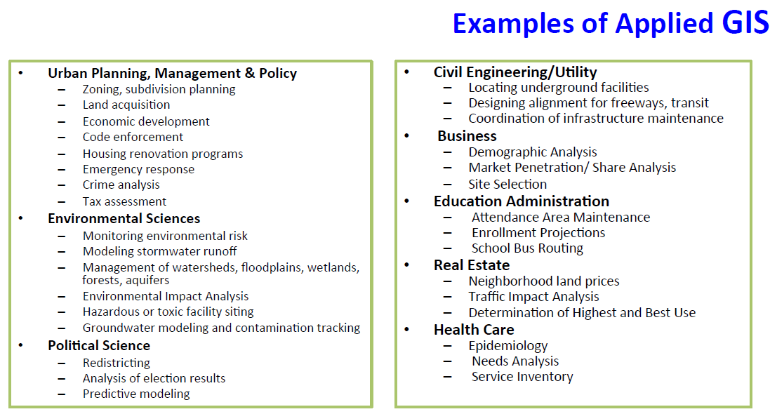

Slide 20
What can you do with a GIS?
The possibilities are unlimited…
  Environmental impact assessment
  Resource management
  Land use planning
  Tax Mapping
  Water and Sanitation Mapping
  Transportation routing
  Mineral exploration
  and more ...

Slide 21
How does a GIS work?
GIS data has a spatial/geographic reference
  This might be a reference that describes a feature on the earth using:
    a latitude & longitude
    a national coordinate system
    an address
    a district
    a wetland identifier
    a road name

Slide 22
Key functions of GIS
Data can be:
Positioned by its known spatial coordinates.
Input and organized (generally in layers).
Stored and retrieved.
Analyzed (usually via a Relational DBMS).
Modified and displayed

Slide 23
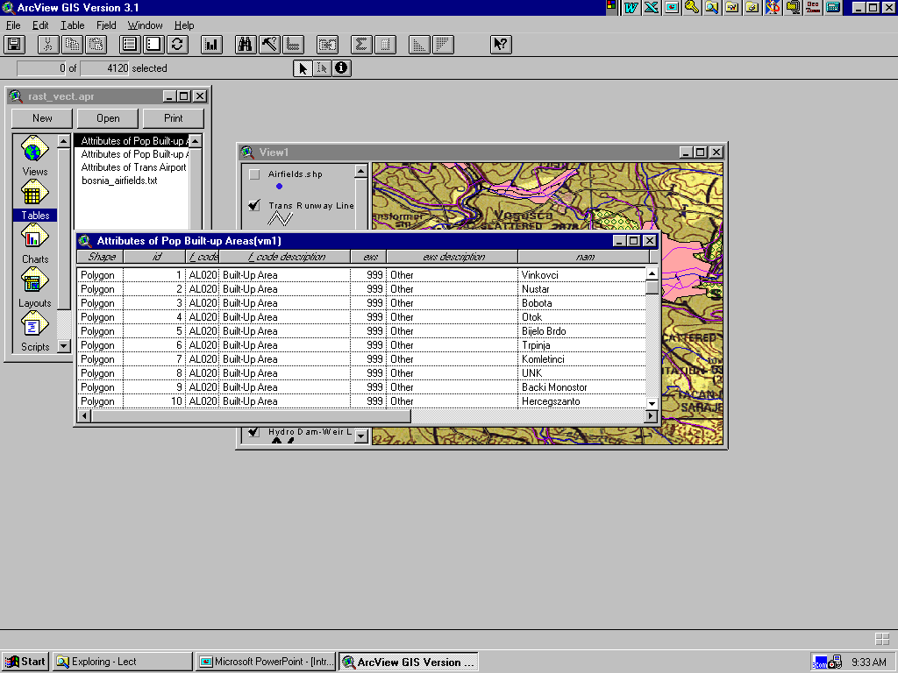
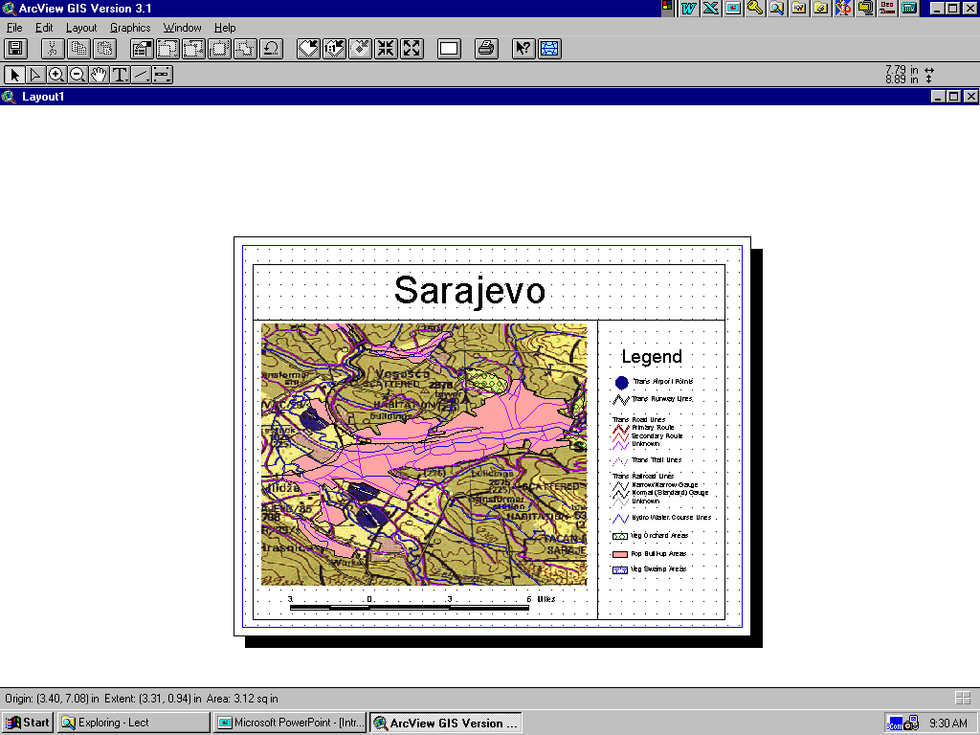
Key functions of GIS
Tables
Maps
Interactive Displays
3-D Perspective View

Slide 24
GIS Process
Define
problem
Decision
GIS
Process
Output
Define GIS
criteria
GIS
analysis
Import or
build datasets

Slide 25
References
Book "Introduction to Geographic Information System”
Fundamentals of Geographic Information System

